Slide 1

Comparing the neighborhoods of the two New York City and Toronto Denny Thomas 27th November 2020

Slide 2


Compare the neighborhoods of the two cities
Different Cities have different facilities . There fore compare the cities based on the facilities will bring a competitive advantages for the people
Calculating the distance matrix
Helps to compare the similarity of neighborhoods
Helps to select the similar neighborhoods with respect to the present status

Slide 3

Data acquisition and cleaning
Wikipedia: - Used for identifying the neighborhoods of the cities and analyzing the demographic and climatic data, this data will be used for clustering the neighbor hood
Foursquare API- Used for exploring the venue and venue type, this data will be used for clustering the neighbor hood
Total 14,549 venues grouped in to 463 categories are extracted

Slide 4
Relationship with the Neighborhoods
Borough | City | Neighborhood | Allerton | Baychester | Bedford Park | Deer Park | Forest Hill Road Park | Forest Hill SE
Bronx | New York City, NY | Allerton | 0.0000 | 0.2593 | 0.2264 | 0.2809 | 0.5270 | 0.6055
Bronx | New York City, NY | Baychester | 0.2593 | 0.0000 | 0.2631 | 0.2877 | 0.5104 | 0.5958
Bronx | New York City, NY | Bedford Park | 0.2264 | 0.2631 | 0.0000 | 0.2794 | 0.5212 | 0.6111
Central Toronto | Toronto, Canada | Deer Park | 0.2809 | 0.2877 | 0.2794 | 0.0000 | 0.5000 | 0.5963
Central Toronto | Toronto, Canada | Forest Hill Road Park | 0.5270 | 0.5104 | 0.5212 | 0.5000 | 0.0000 | 0.6667
Central Toronto | Toronto, Canada | Forest Hill SE | 0.6055 | 0.5958 | 0.6111 | 0.5963 | 0.6667 | 0.0000

Slide 5
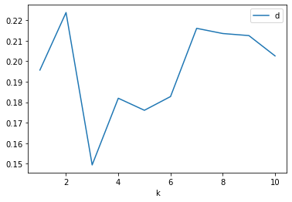
Clustering (K means)

Slide 6
Clustering (K means)
Cluster 0: -455 no’s of Neighborhoods
Cluster1: - 27 Nos of Neighborhoods
Cluster2:- 3 Nos of Neighborhoods

Slide 7
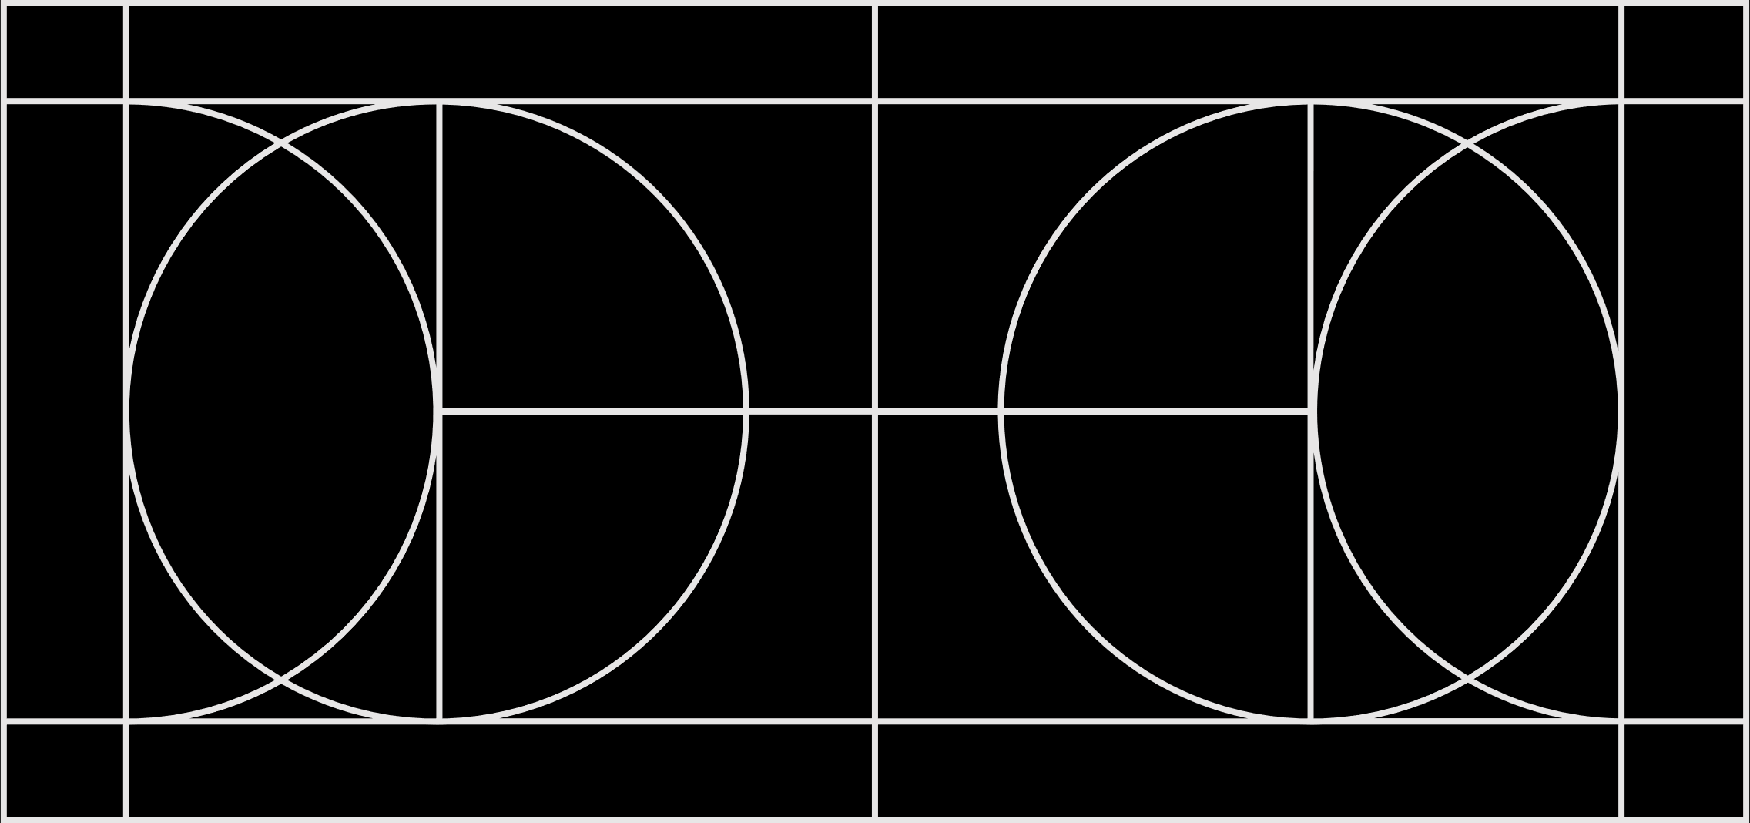
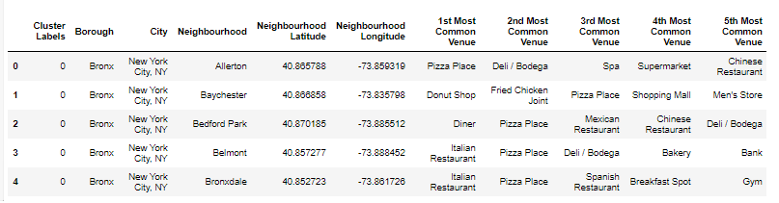
Table with first 5 common venues

Slide 8
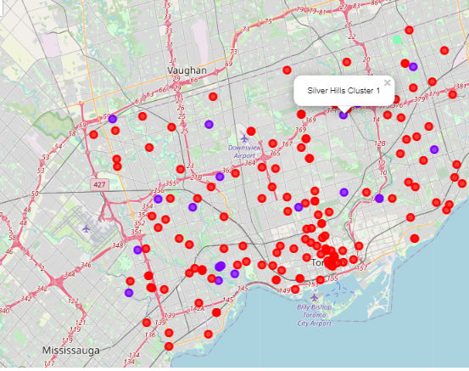
Visualizing the Neighborhoods in Folium Torronto Neighborhoods

Slide 9
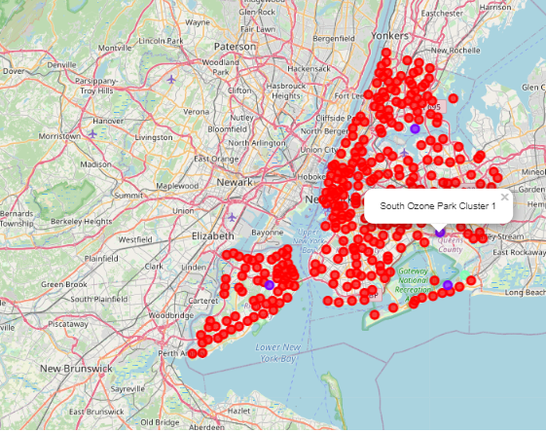
Visualizing the Neighborhoods in Folium New York Neighborhoods

Slide 10
Conclusion and future directions
Analyzed the similarity neighborhoods Toronto and New York City
Grouped the neighborhoods in to 3 clusters
Generated the This distance matrix
Ideas include:
Climate
Population,
Per capita income

